Slide 1
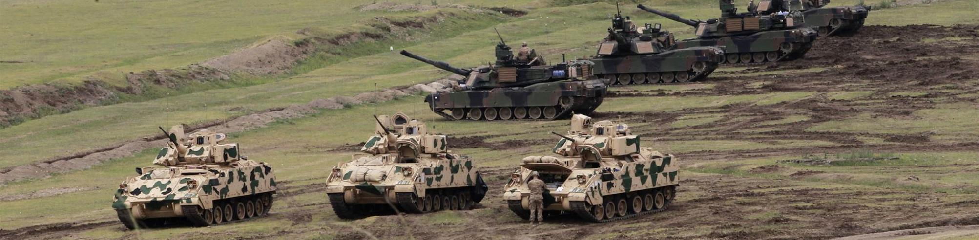
dcs world moose user missions explained ground offensive from “gunterlund”

